Slide 1
LAB 03: SCATTERPLOTS
September 29, 2016
SDS 136
Communicating with Data

Slide 2
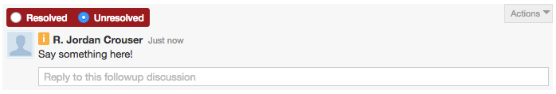
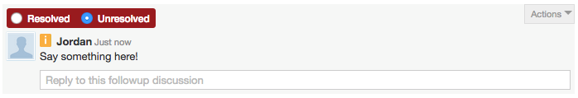
Announcements
Introducing Aditya (our new grader!)
Some notes on Piazza:
You can check your graded / missing assignments and labs at any time on Moodle
Leave this
unresolved please
Full name
(or 1st and initial)
please

Slide 3
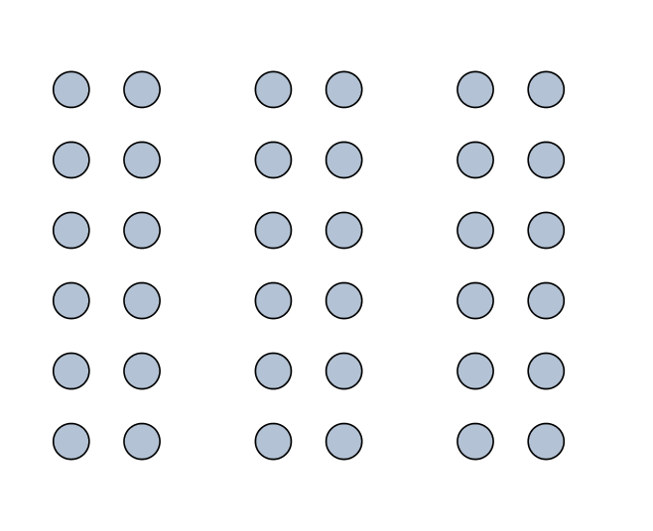
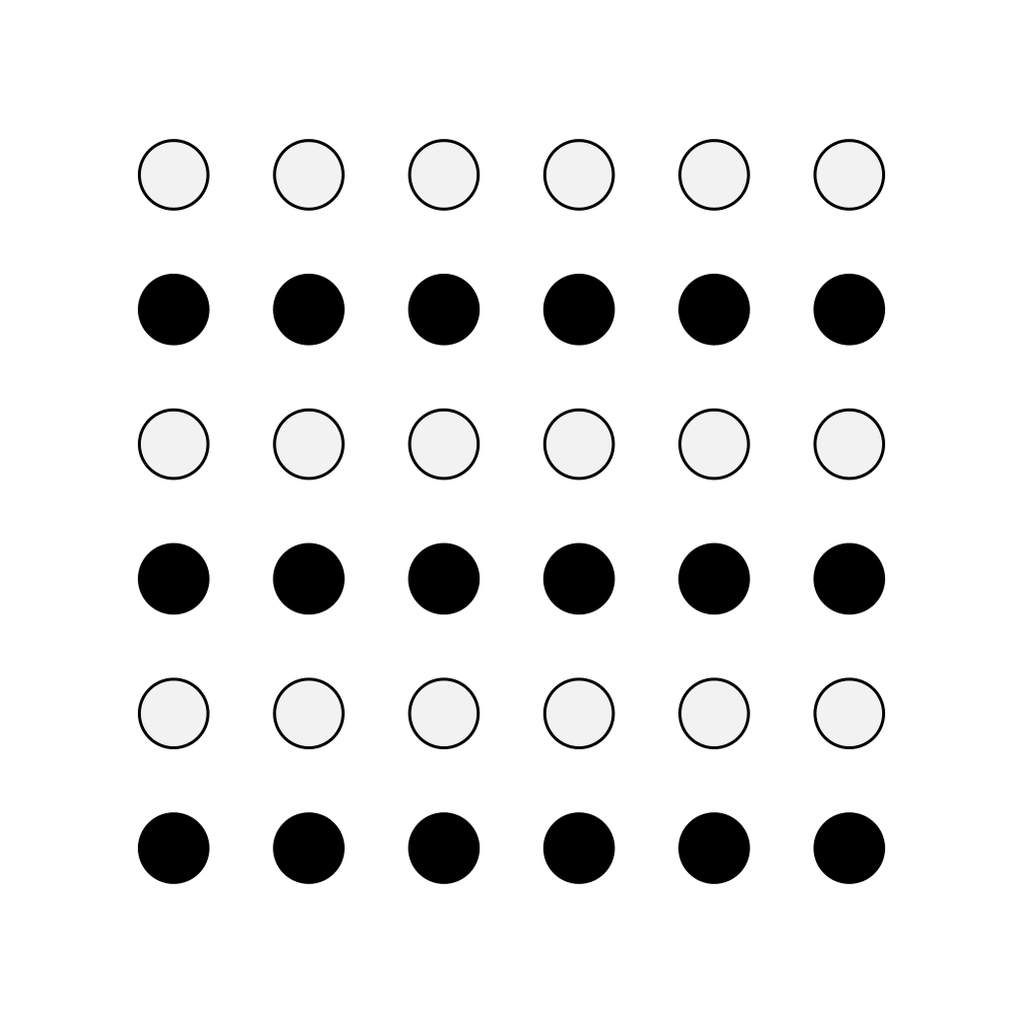
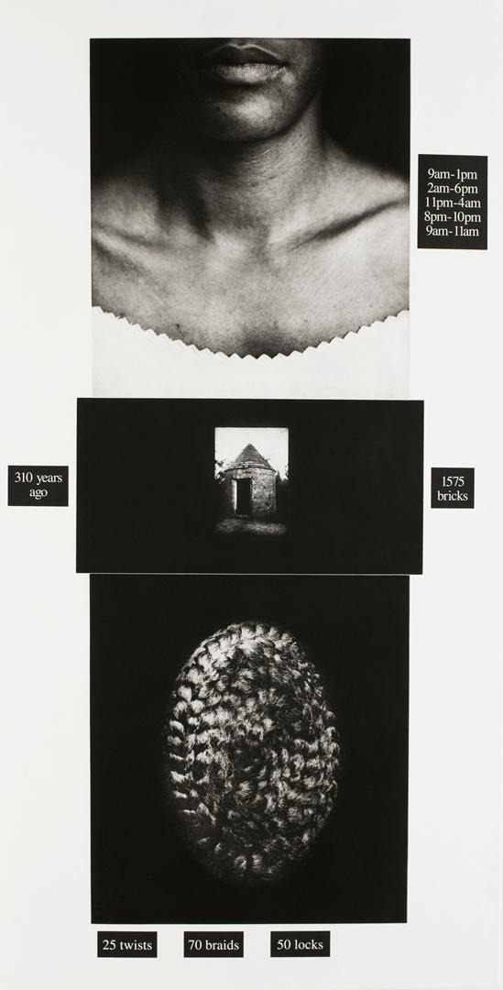
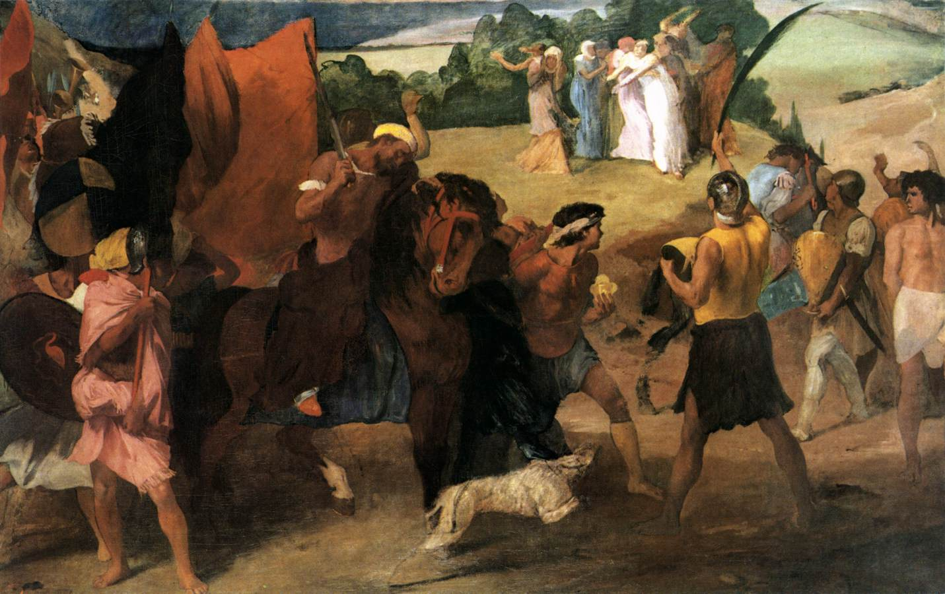



SCMA Visit #1: debrief
proximity
similarity
[ ]
symmetry
closure
common fate
continuity

Slide 4
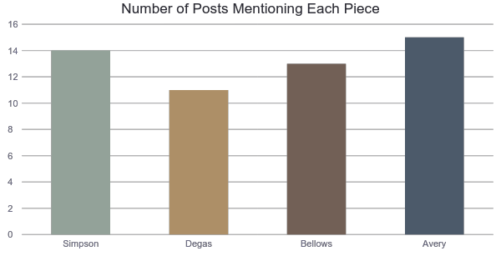
SCMA Visit #1: some data

Slide 5
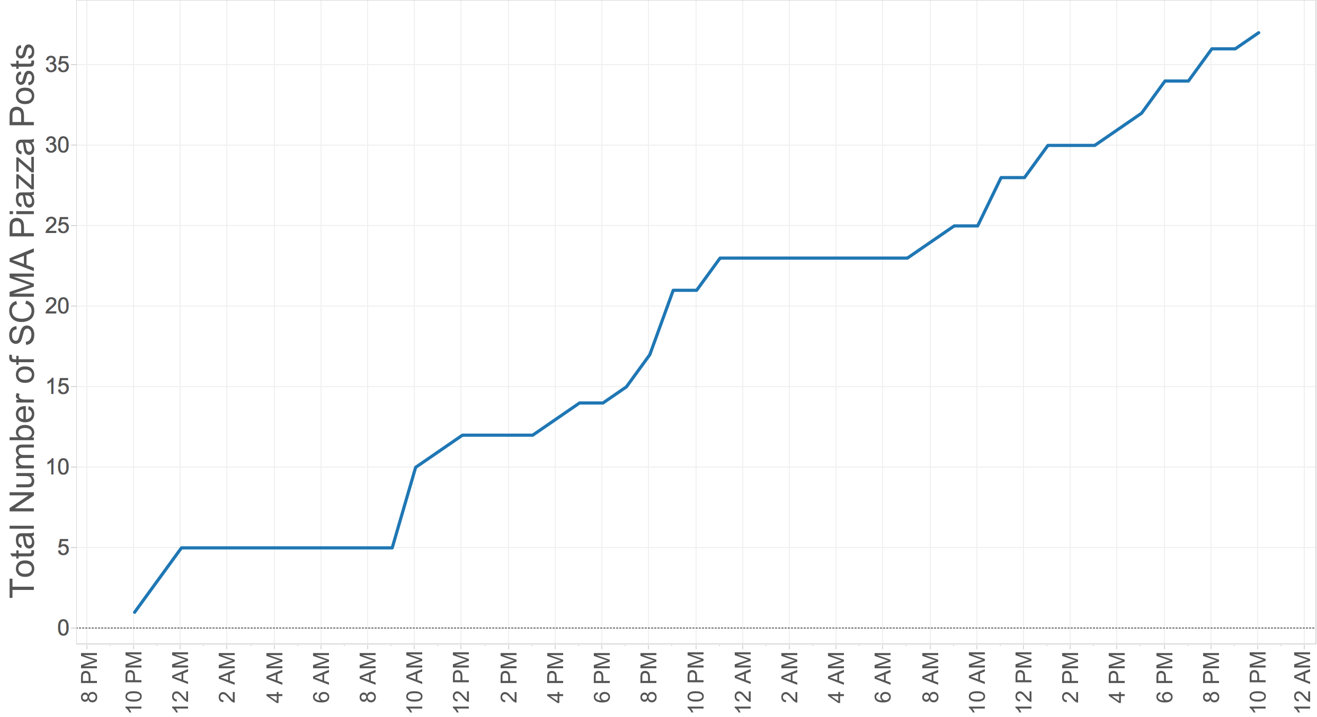
SCMA Visit #1: some more data
Tuesday Sept. 27
Wednesday Sept. 28

Slide 6
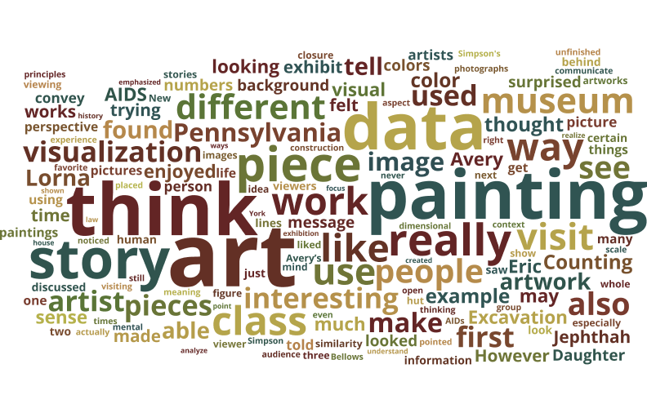
SCMA Visit #1: even MORE data

Slide 7
Outline
Scatterplots
Definitions
Comparing multiple categories
What gets encoded?
Pros and cons
Questions to ask
Things to watch out for
Lab 3: Building scatterplots in Tableau

Slide 8
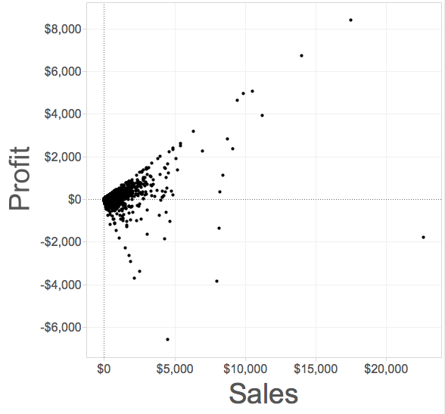
Scatterplot
Definition: a visualization that shows the correlation between two quantitative (numerical) variables
Each point represents an observation
One axis shows one quantitative measure
The other axis shows a second quantitative measure

Slide 9
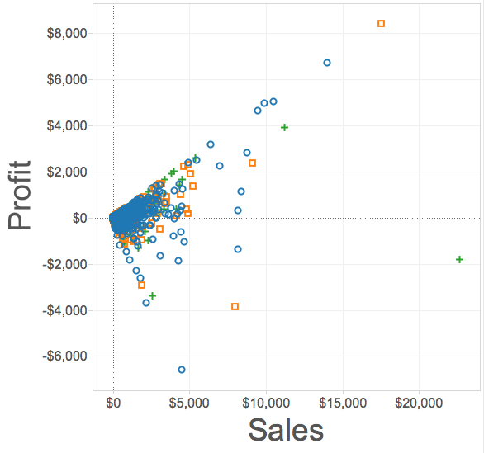
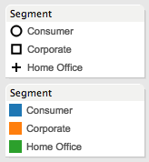
Scatterplots on multiple categories
We can change the mark type to compare the same variables across different categories

Slide 10
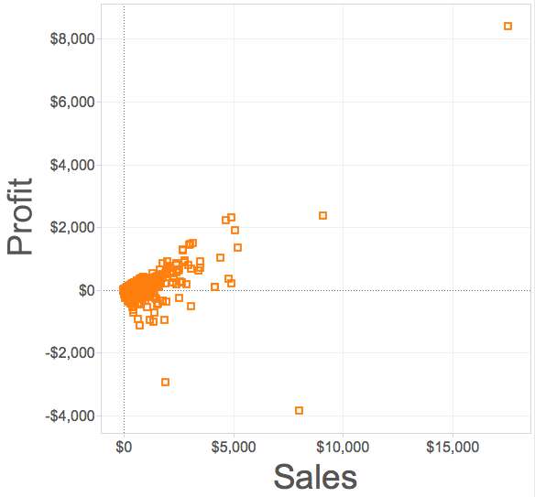
Correlation
Scatterplots are particularly useful for highlighting correlation (what’s that?)
(whether the variables tend to change together)
Trend line (a.k.a “line of best fit”)

Slide 11
Trend lines
May pass through all, some, or none of the data points
Useful for making predictions
Trend line (a.k.a “line of best fit”)

Slide 12
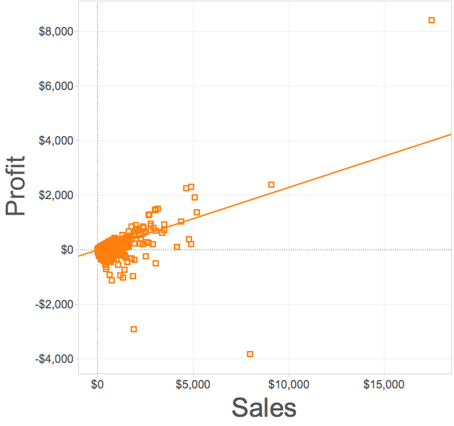
Positive correlation
Two variables moving in the same direction
Trend line points up and to the right

Slide 13


Positive correlation: example

Slide 14
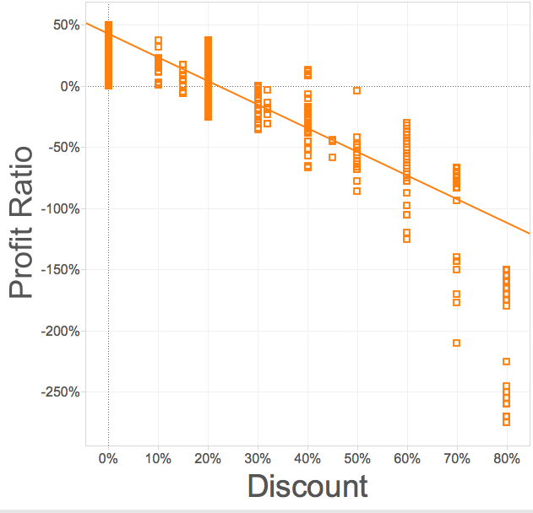
Negative correlation
Two variables moving in opposite directions
Trend line points down and to the right

Slide 15

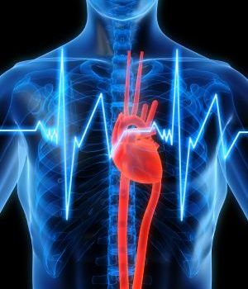
Negative correlation: example

Slide 16
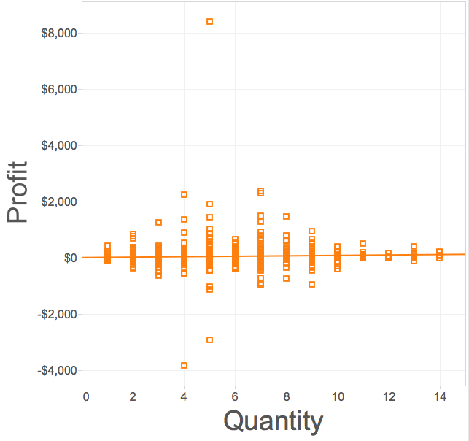
No correlation
Two variables are independent of one another
No discernable pattern
Trend line is flat

Slide 17
No correlation: example

Slide 18
What gets encoded
Maximum value(s) in each dimension
General trend
(what law is at work here?)
Outliers (points that are “far from the pack”)
Minimum value(s) in each dimension

Slide 19

Pros and cons
What’s good about scatterplots?
What’s not so good?

Slide 20
Questions to ask
How many categories?
Examine the data to figure out how many different categories you want to show
Use this to determine your symbols (don’t forget labels!)
What’s the range for V1?
Examine the data to identify the biggest and smallest values for the first variable
Use this value to scale your first axis
What’s the range for V2?
Examine the data to identify the biggest and smallest values for the second variable
Use this value to scale your second axis

Slide 21
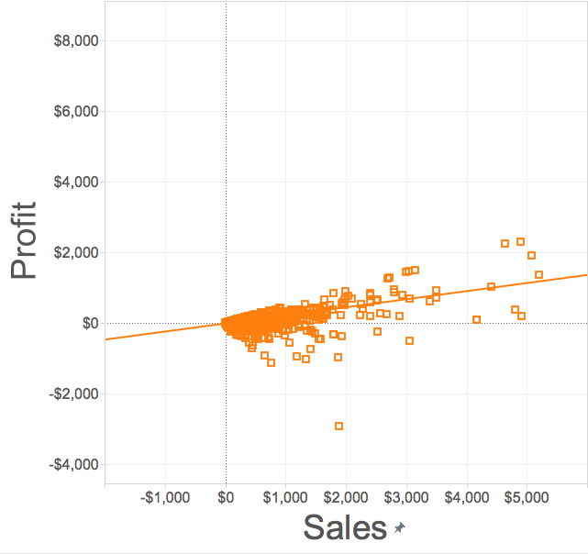
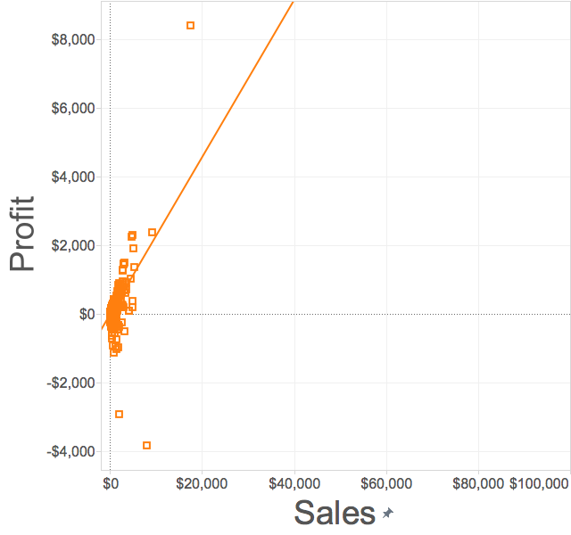
Things to watch out for
Choice of scale matters

Slide 22
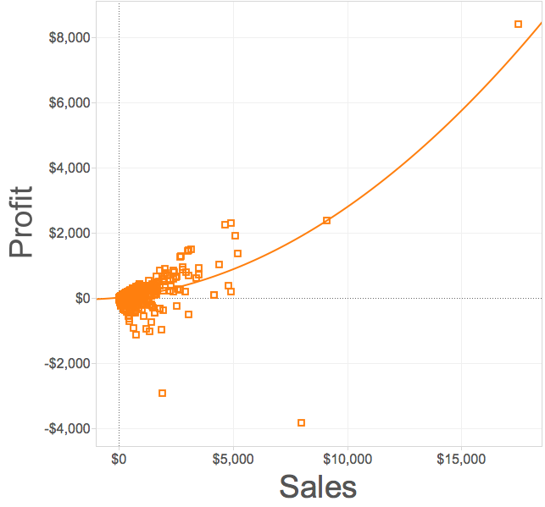
Things to watch out for
Linear
Quadratic
Choice of model matters

Slide 23
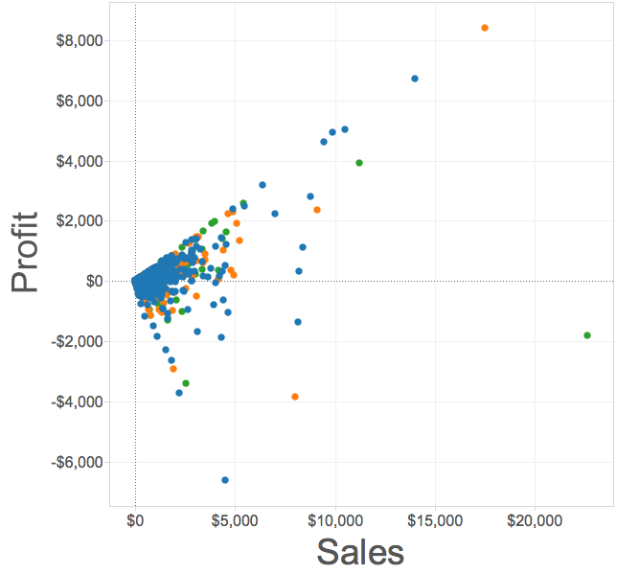
Things to watch out for
Overplotting can make it hard to tell
what’s going on in different categories

Slide 24
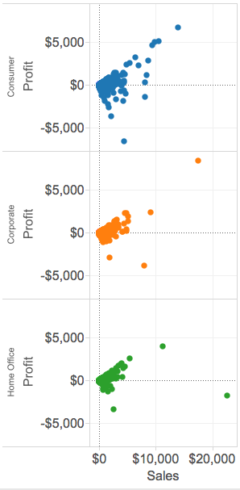
Things to watch out for
When this is the case, using
small multiples can sometimes help

Slide 25
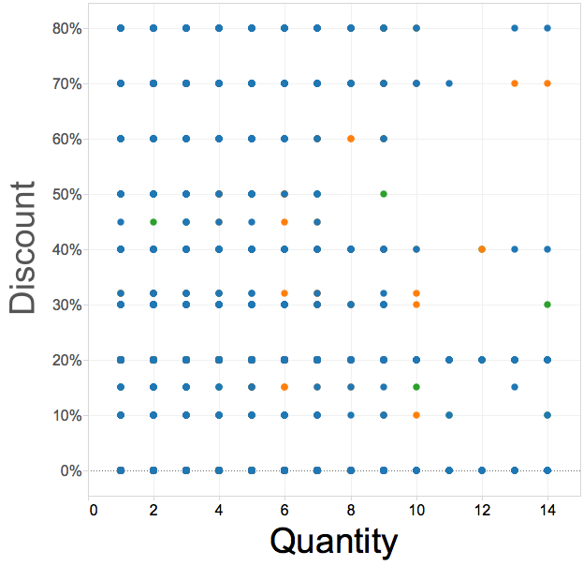
Things to watch out for
Variables with only a few unique values can also pose a problem

Slide 26
Lab 3: scatterplots
Instructions for today’s lab are available at:
www.science.smith.edu/~jcrouser/SDS136/labs/lab3/

Slide 27
Instant replay: pros and cons
What’s good about scatterplots?
What’s not so good?

Slide 28
Up next
A1 due tonight by 11:59pm
Assignment 2 has been posted
Due Thursday Oct. 4th by 11:59pm
Tuesday: perception

